Slide 1
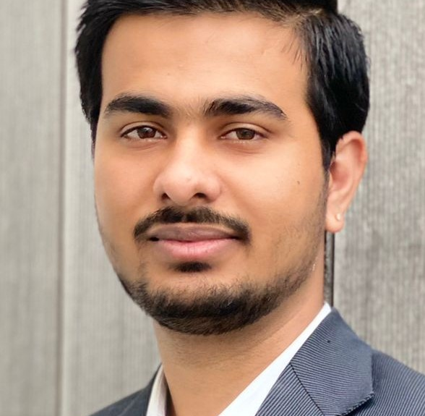
CV Template
Abhishek Danalakota
DevOps/Azure Cloud Engineer
Proposed role: ---
Abhishek is in EY UKI MCSG Ireland for last 1.6 years and has total of 4+ years of IT experience. In which Abhishek has two years of Cloud Consulting experience and overall four years of IT experience who is passionate about Microsoft Azure and automation. Abhishek has technical expertise and hands-on working experience with Microsoft Azure, Azure DevOps, Git, Cloud Infrastructure as Code deployment – terraform, DevOps deployment of microservices and Molithic architecture, Progaming – primarly python, scripting – Powershell and CLI tools and various services/ deployment automation solutions.

